Slide 1
UCSD Embedded Linux Assignment 2
By
Hsuankai Chang
hsuankac@umich.edu

Slide 2
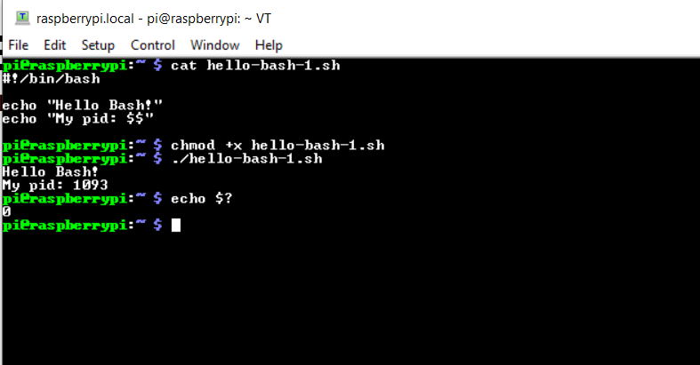
Step 1. Hello Bash - Demo 1. Foreground Program Runs to Completion

Slide 3
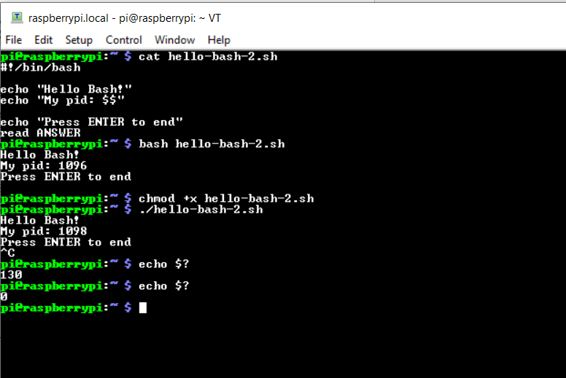
Step 2. Hello Bash - Demo 2. Foreground Program Ended by Pressing ENTER or Control+c

Slide 4
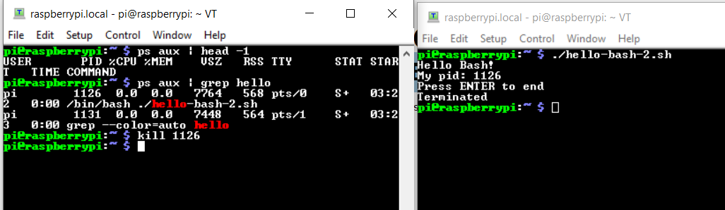
Step 3. Hello Bash - Demo 2. Foreground Program Ended by kill

Slide 5
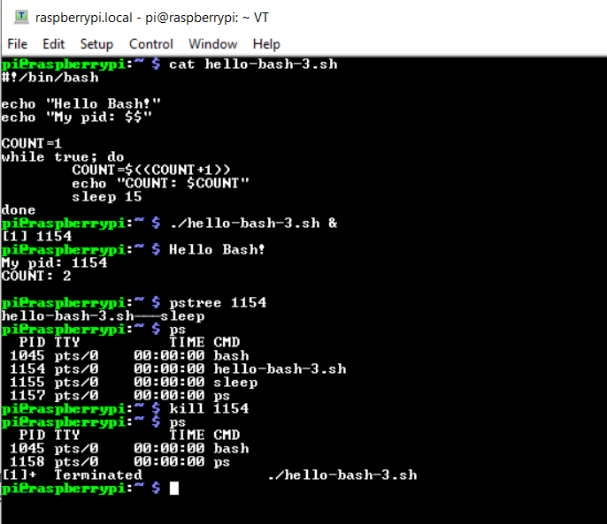
Step 4. Hello Bash - Demo 3. Run in Background

Slide 6
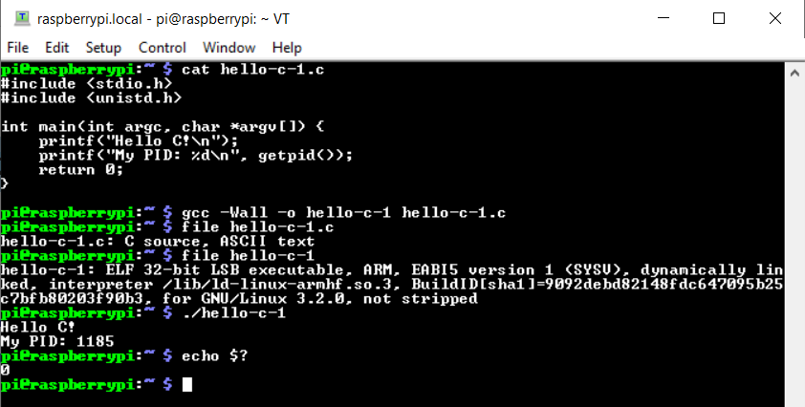
Step 5. Hello C - Demo 1. Foreground Program Runs to Completion

Slide 7
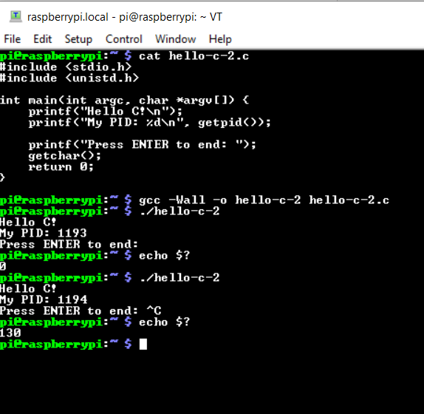
Step 6. Hello C - Demo 2. Foreground Program Ended by Pressing ENTER or Control+c

Slide 8
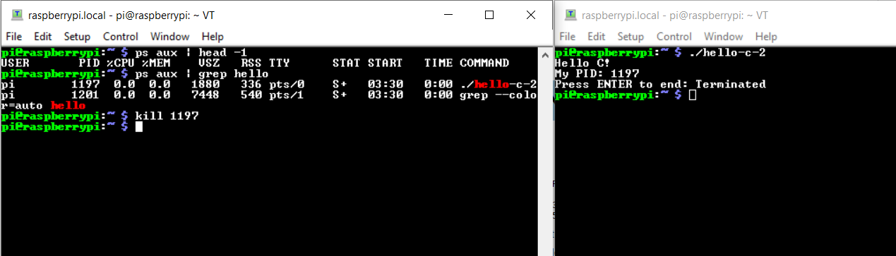
Step 7. Hello C - Demo 2. Foreground Program Ended by kill

Slide 9
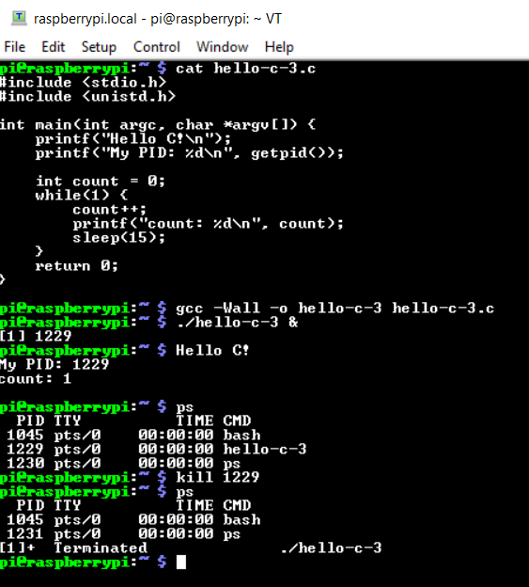
Step 8. Hello C - Demo 3. Run in Background

Slide 10
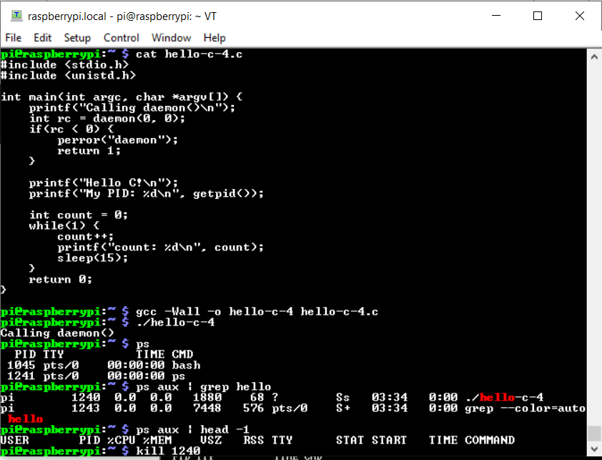
Step 9. Hello C - Demo 4. Run as Daemon

Slide 11
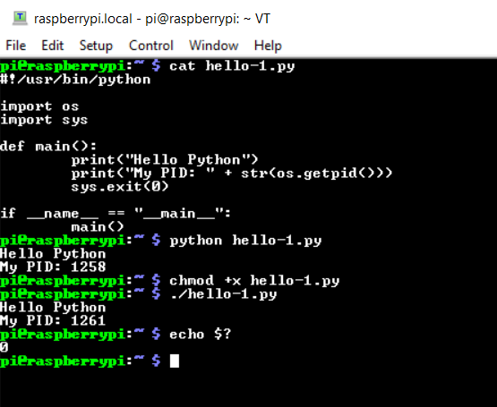
Step 10. Hello Python - Demo 1. Foreground program runs to completion

Slide 12
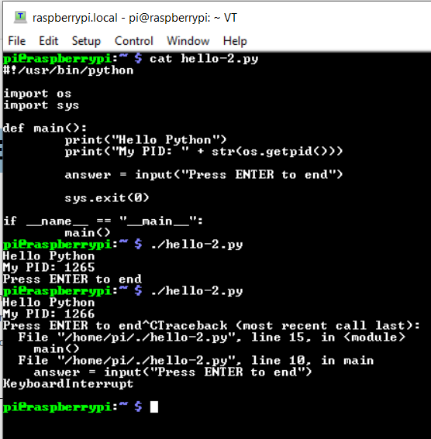
Step 11. Hello Python - Demo 2. Foreground Program Ended by Pressing ENTER or Control+c

Slide 13
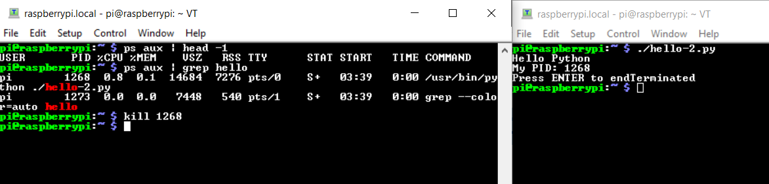
Step 12. Hello Python - Demo 2. Foreground Program Ended by kill

Slide 14
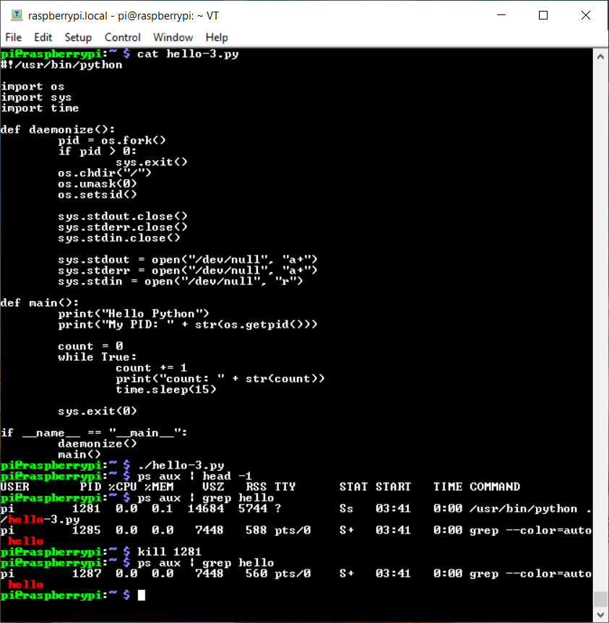
Step 13. Hello Python - Demo 3. Run Python Program as Daemon

